Slide 1

WELCOME
SUBJECT: CHEMISTRY
CLASS : IX
SHEIKH MAHMUDUR RAHMAN
COMPUTER STUDIES
BANGLADESH INTERNATIONAL SCHOOL AND COLLEGE

Slide 2
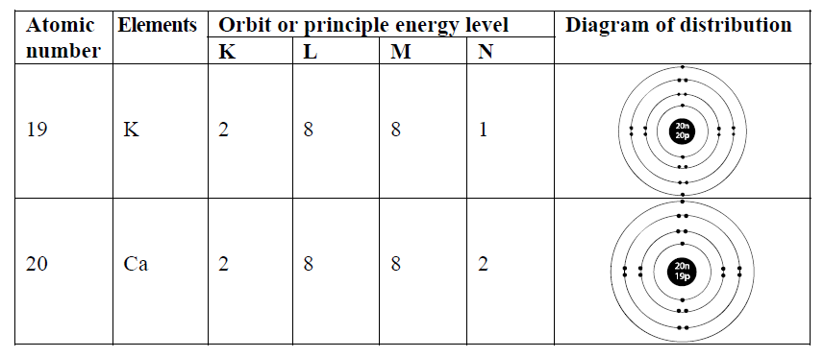
1. Direction of reaction
2. Heat change of reaction
3. Electron transition
RECAP OF PREVIOUS CLASS
CHEMICAL SYMBOLS AND FORMULA
VALENCY
TYPES OF REACTION

Slide 3
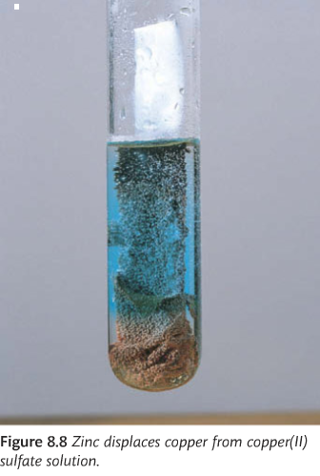
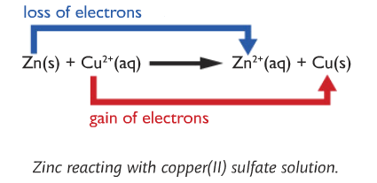
TOPIC: REDOX REACTION

Slide 4
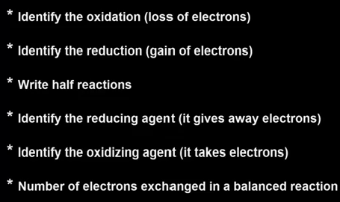
LEARNING OUTCOMES
AFTER THE COMPLETION OF THE LESSON STUDENTS WILL BE ABLE TO LEARN:
1
2
Compare oxidizing/reducing agents
3
Determine the Oxidation number
Redox reaction
4
Halt reactions
5
oxidation and reduction reactions
6

Slide 5
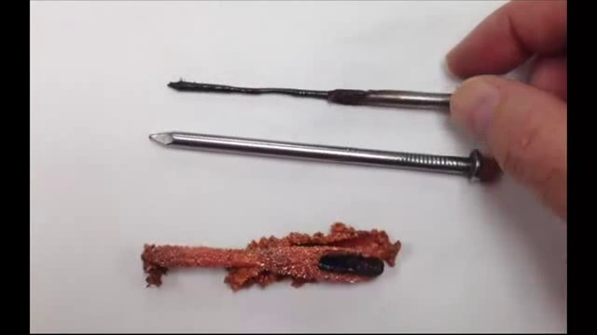
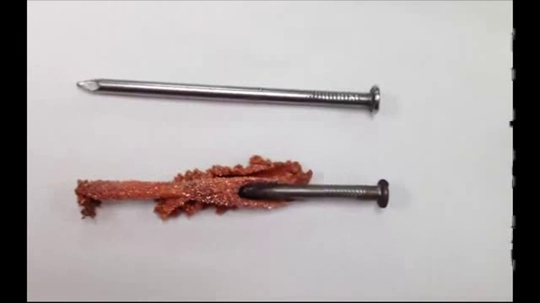
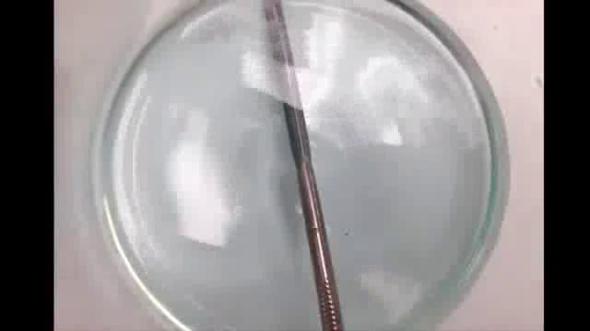
REDOX
‘RED’ OF REDUCTION
‘OX’ OF
OXIDATION
donating or releasing electrons by reactants
Fe - 2e⁻ Fe²⁺
accepting or receiving electrons by reactants Cu²⁺ + 2e⁻ Cu
The chemical which loses electrons, is oxidised (increases its valency) and is called the reducing agent.
The chemical which gains electrons is reduced (reduces its valency) and is called the oxidising agent.

Slide 6
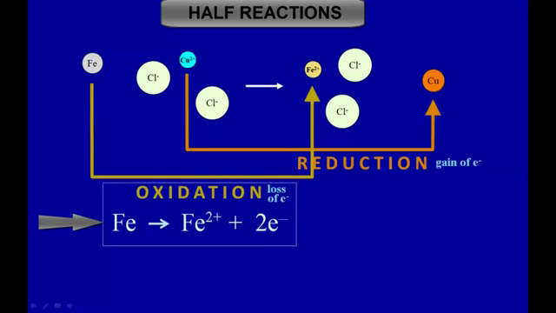
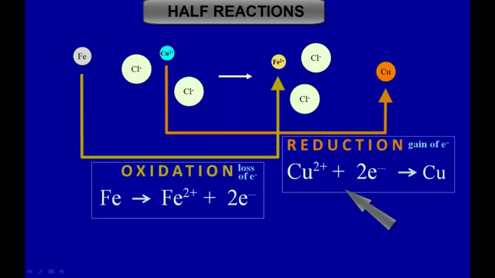
HALF EQUATION
Fe
Fe Fe²⁺ + 2e⁻
Cu + 2e⁻ Cu
Cu
Zn
Zn Zn²⁺+ 2e⁻
SO₄⁻ + 2e⁻ SO₄
SO₄⁻

Slide 7
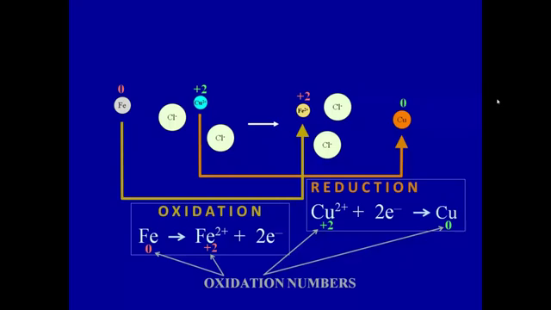
OXIDATION NUMBERS

Slide 8
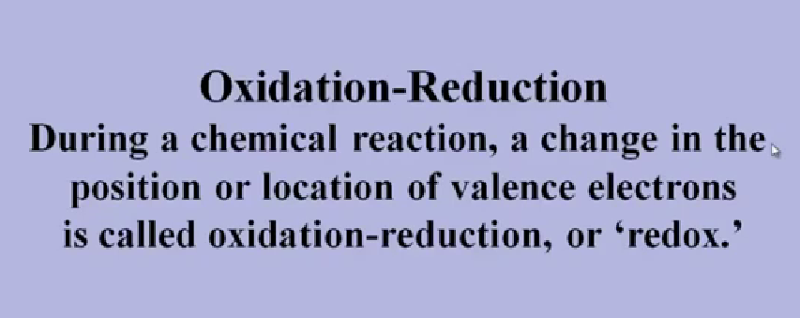
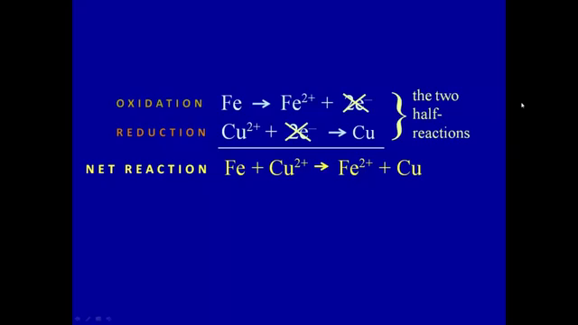
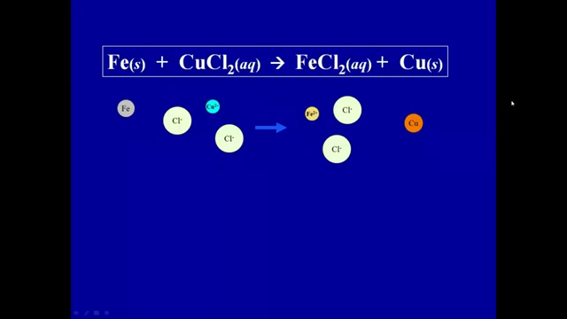
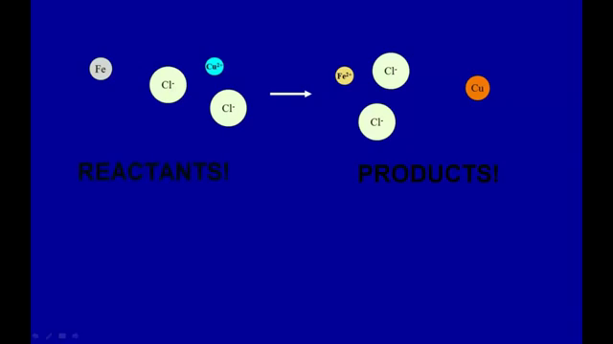
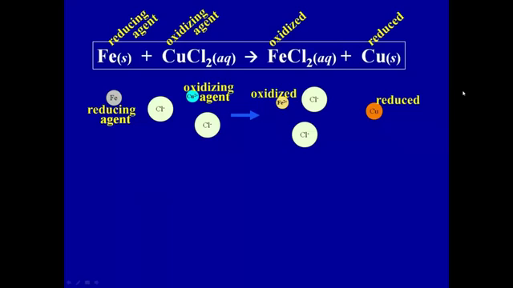

Slide 9
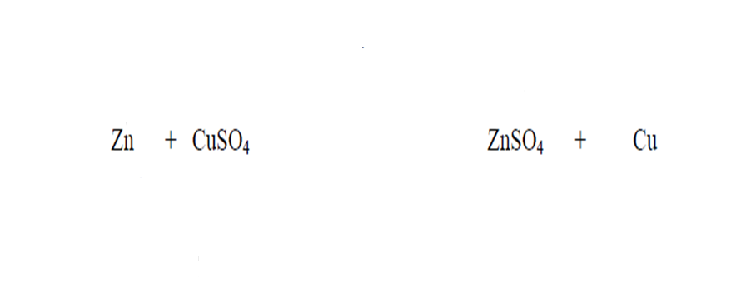
GROUP WORK
Label the above equation:
1. IDENTIFY THE REDUCING AND OXIDIZING AGENTS
2. IDENTIFY WHICH ELEMENT IS REDUCED AND OXIDIZED
3. LABEL THE OXIDATION AND REDUCTION PATH

Slide 10
EVALUTION
2Na + Cl₂ 2NaCl
1. WHAT IS REDOX REACTION?
2. HOW DO YOU IDENTIFY THE OXIDATION AND REDUCTION?
3. IDENTIFY THE REDUCING AND OXIDIZING AGENTS
4. NUMBER OF ELECTRONS EXCHANGED IN THE ABOVE EQUATION

Slide 11
HOME WORK
PROVE THE FOLLOWING REACTION IS
THE REDOX REACTION
2Na + Cl₂ 2NaCl

Slide 12

THANK YOU ALL

